Slide 1

Copyright © 2024 - PartikelART
INDUSTRIAL DATA SCIENCE 2
CASE STUDY- GROUP III
HARSH YADAV | ANANYA PAL | RAJ ANILBHAI PAWAR |SAPTARSI BHATTACHARYA | PURVANSHI SHARMA

Slide 2
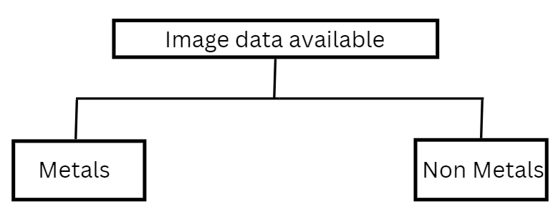
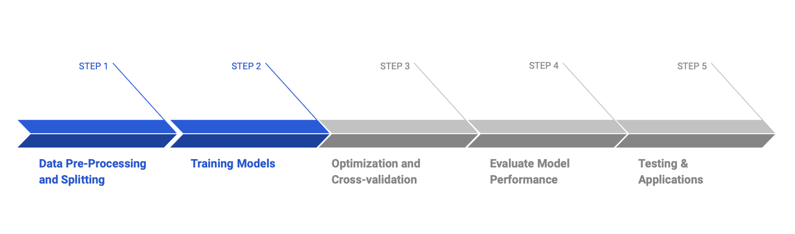
An Overview of the First Presentation
Copyright © 2024 - PartikelART
Problem Statement – In industries where precision and reliability are crucial, the presence of contaminants such as metal and non-metal particles can lead to significant quality issues.
Solution– To address the challenge of particle analysis, we use YOLO and CNN models, and compare their results.
HARSH YADAV | ANANYA PAL | RAJ ANILBHAI PAWAR |SAPTARSI BHATTACHARYA | PURVANSHI SHARMA

Slide 3
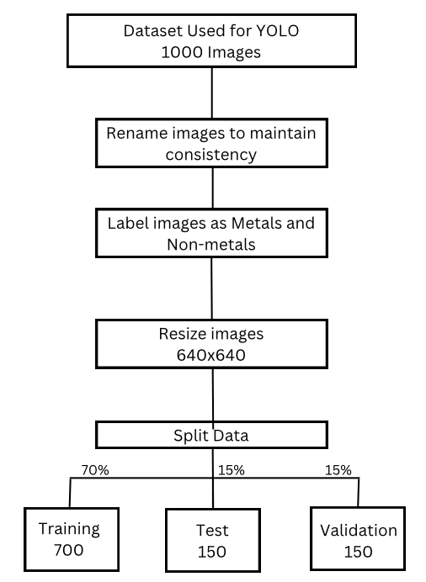
YOLO v8n Model- Methodology
Copyright © 2024 - PartikelART
HARSH YADAV | ANANYA PAL | RAJ ANILBHAI PAWAR |SAPTARSI BHATTACHARYA | PURVANSHI SHARMA

Slide 4
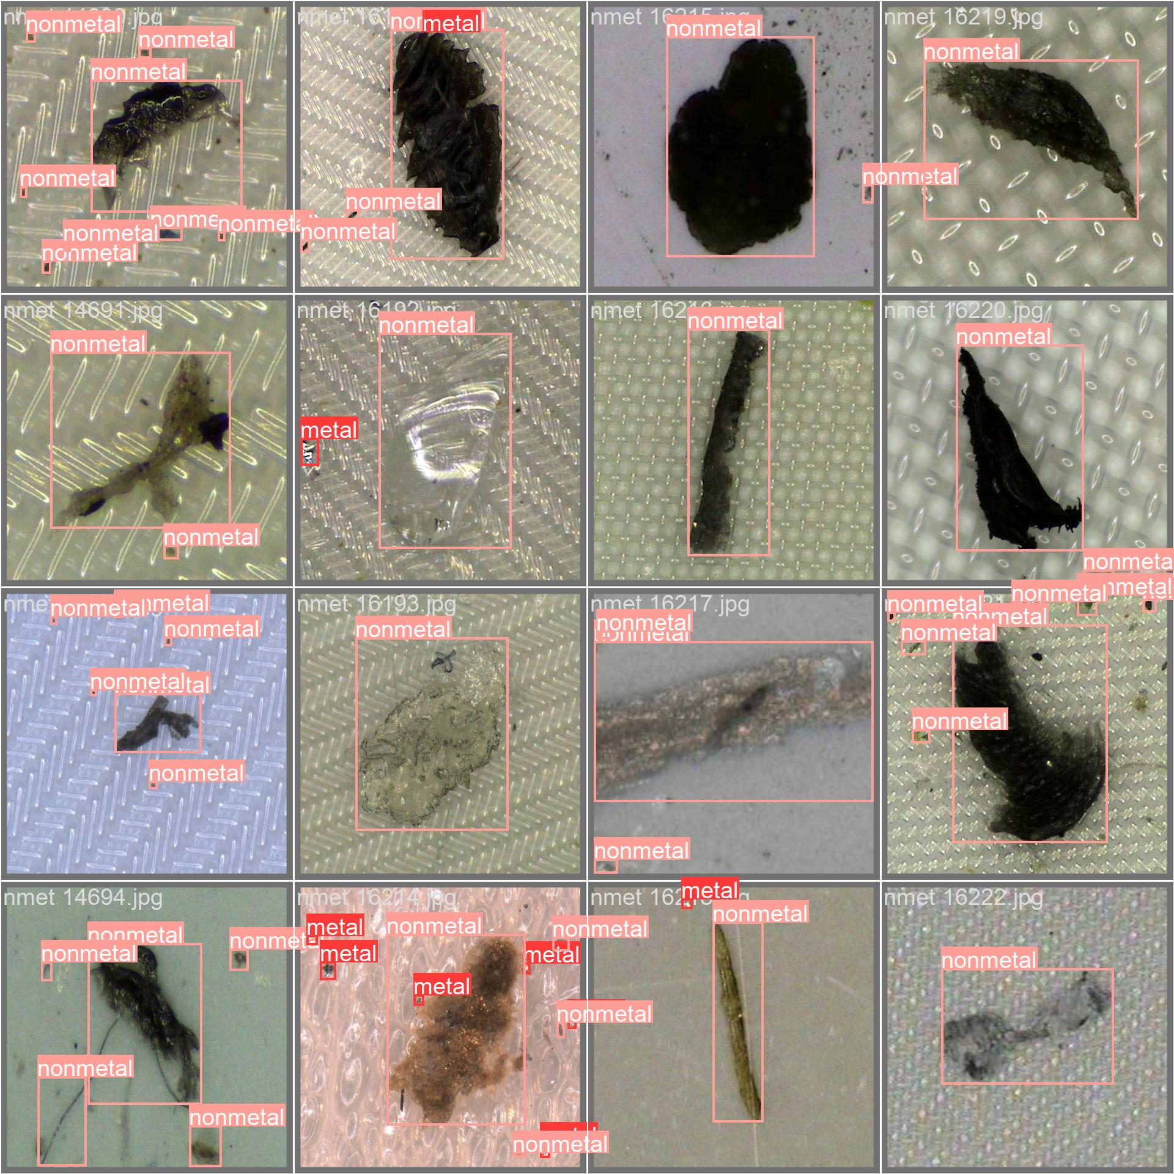
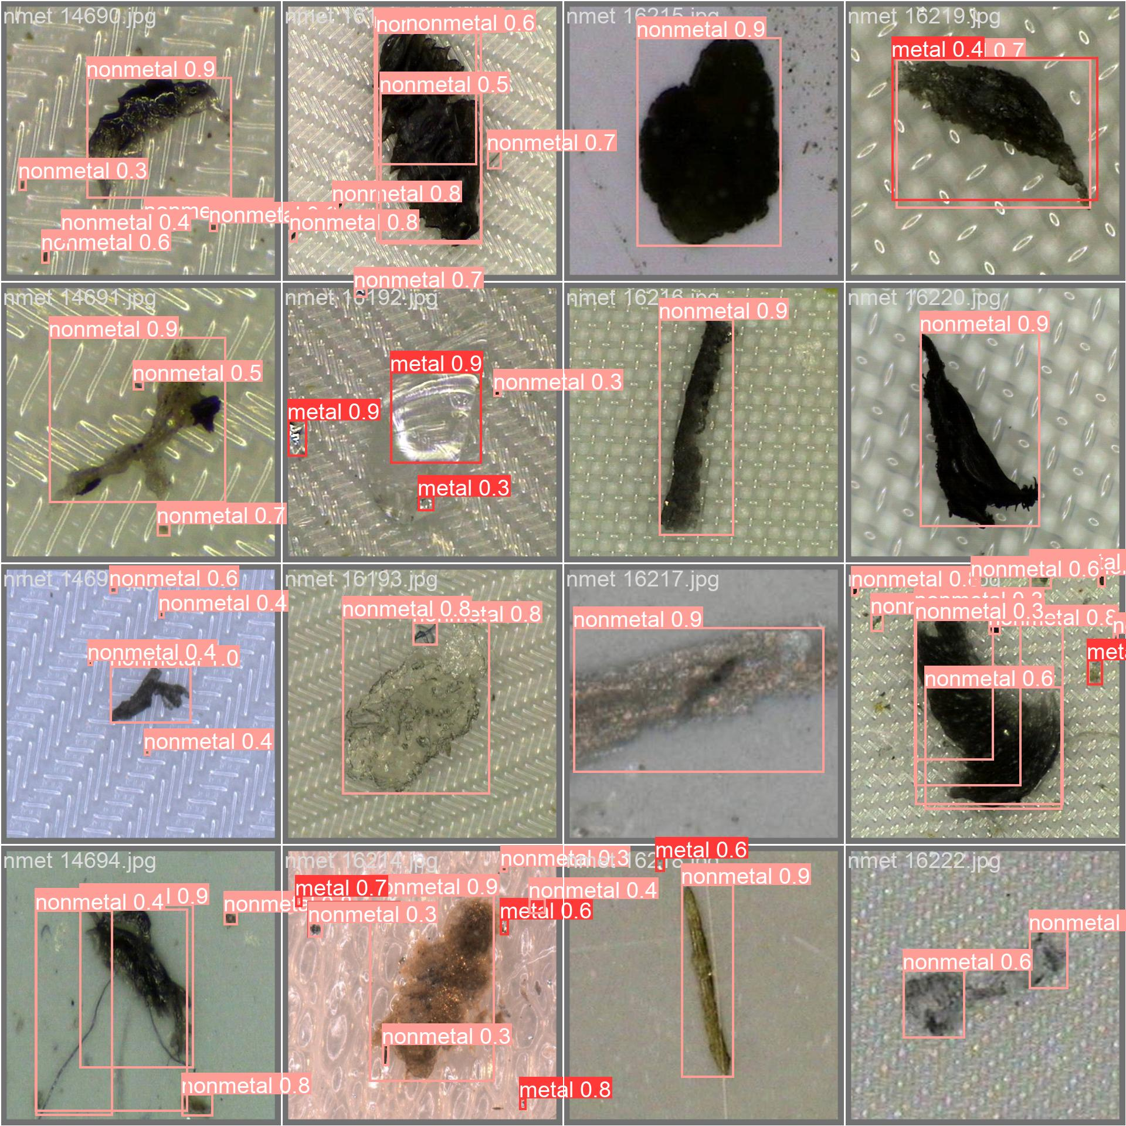
Validation Results- Batch One
*Along each label, the confidence score of prediction is shown.
HARSH YADAV | ANANYA PAL | RAJ ANILBHAI PAWAR |SAPTARSI BHATTACHARYA | PURVANSHI SHARMA

Slide 5
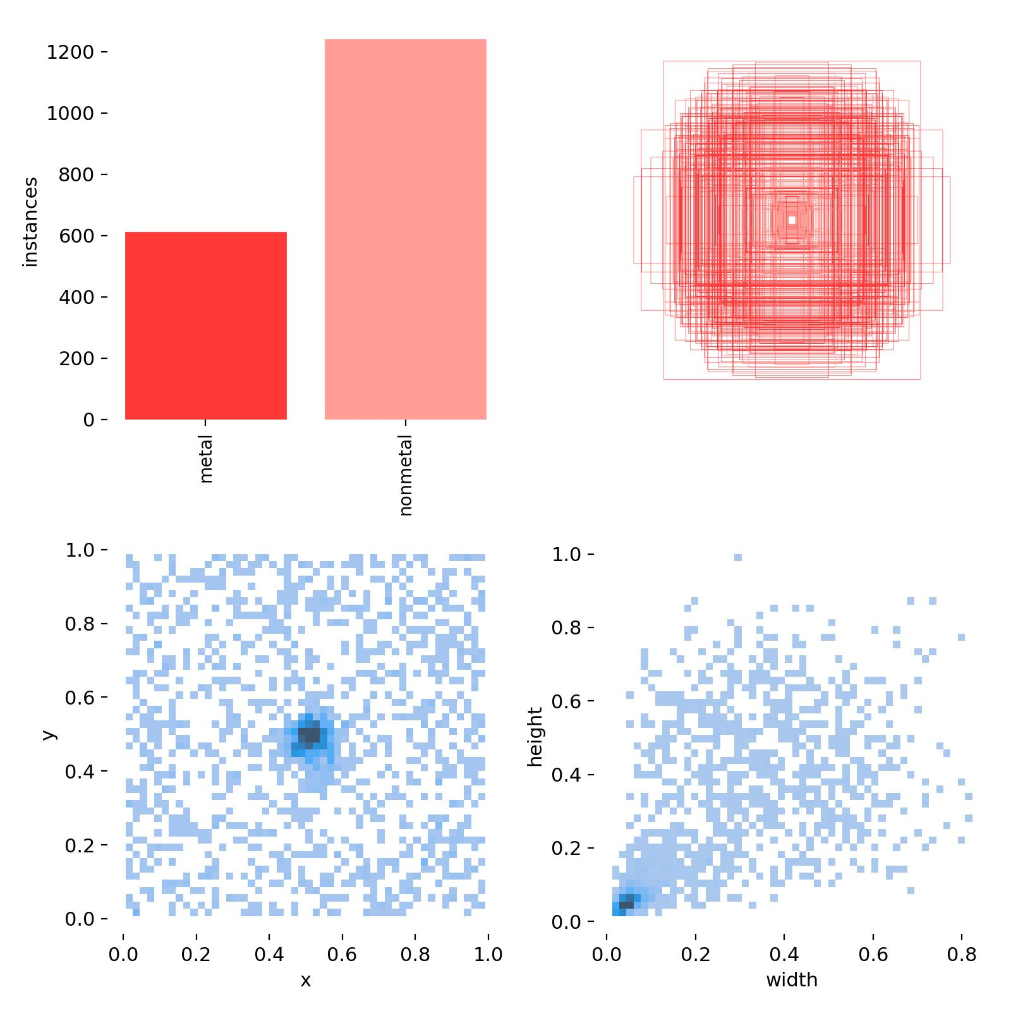
Bar Graph:
Displays the number of instances detected for metals and non-metals.
Scatter Plot (Bounding Boxes Distribution):
Red boxes represent bounding boxes around detected objects.
Illustrates the concentration and spread of object locations within the center of the images.
Scatter Plot (X and Y Coordinates):
Shows the X and Y coordinates of detected objects.
Highlights the positions of objects within the center of the images.
Scatter Plot (Width and Height Distribution):
Displays the width and height distribution of detected objects.
Indicates variations in object sizes.
HARSH YADAV | ANANYA PAL | RAJ ANILBHAI PAWAR |SAPTARSI BHATTACHARYA | PURVANSHI SHARMA

Slide 6
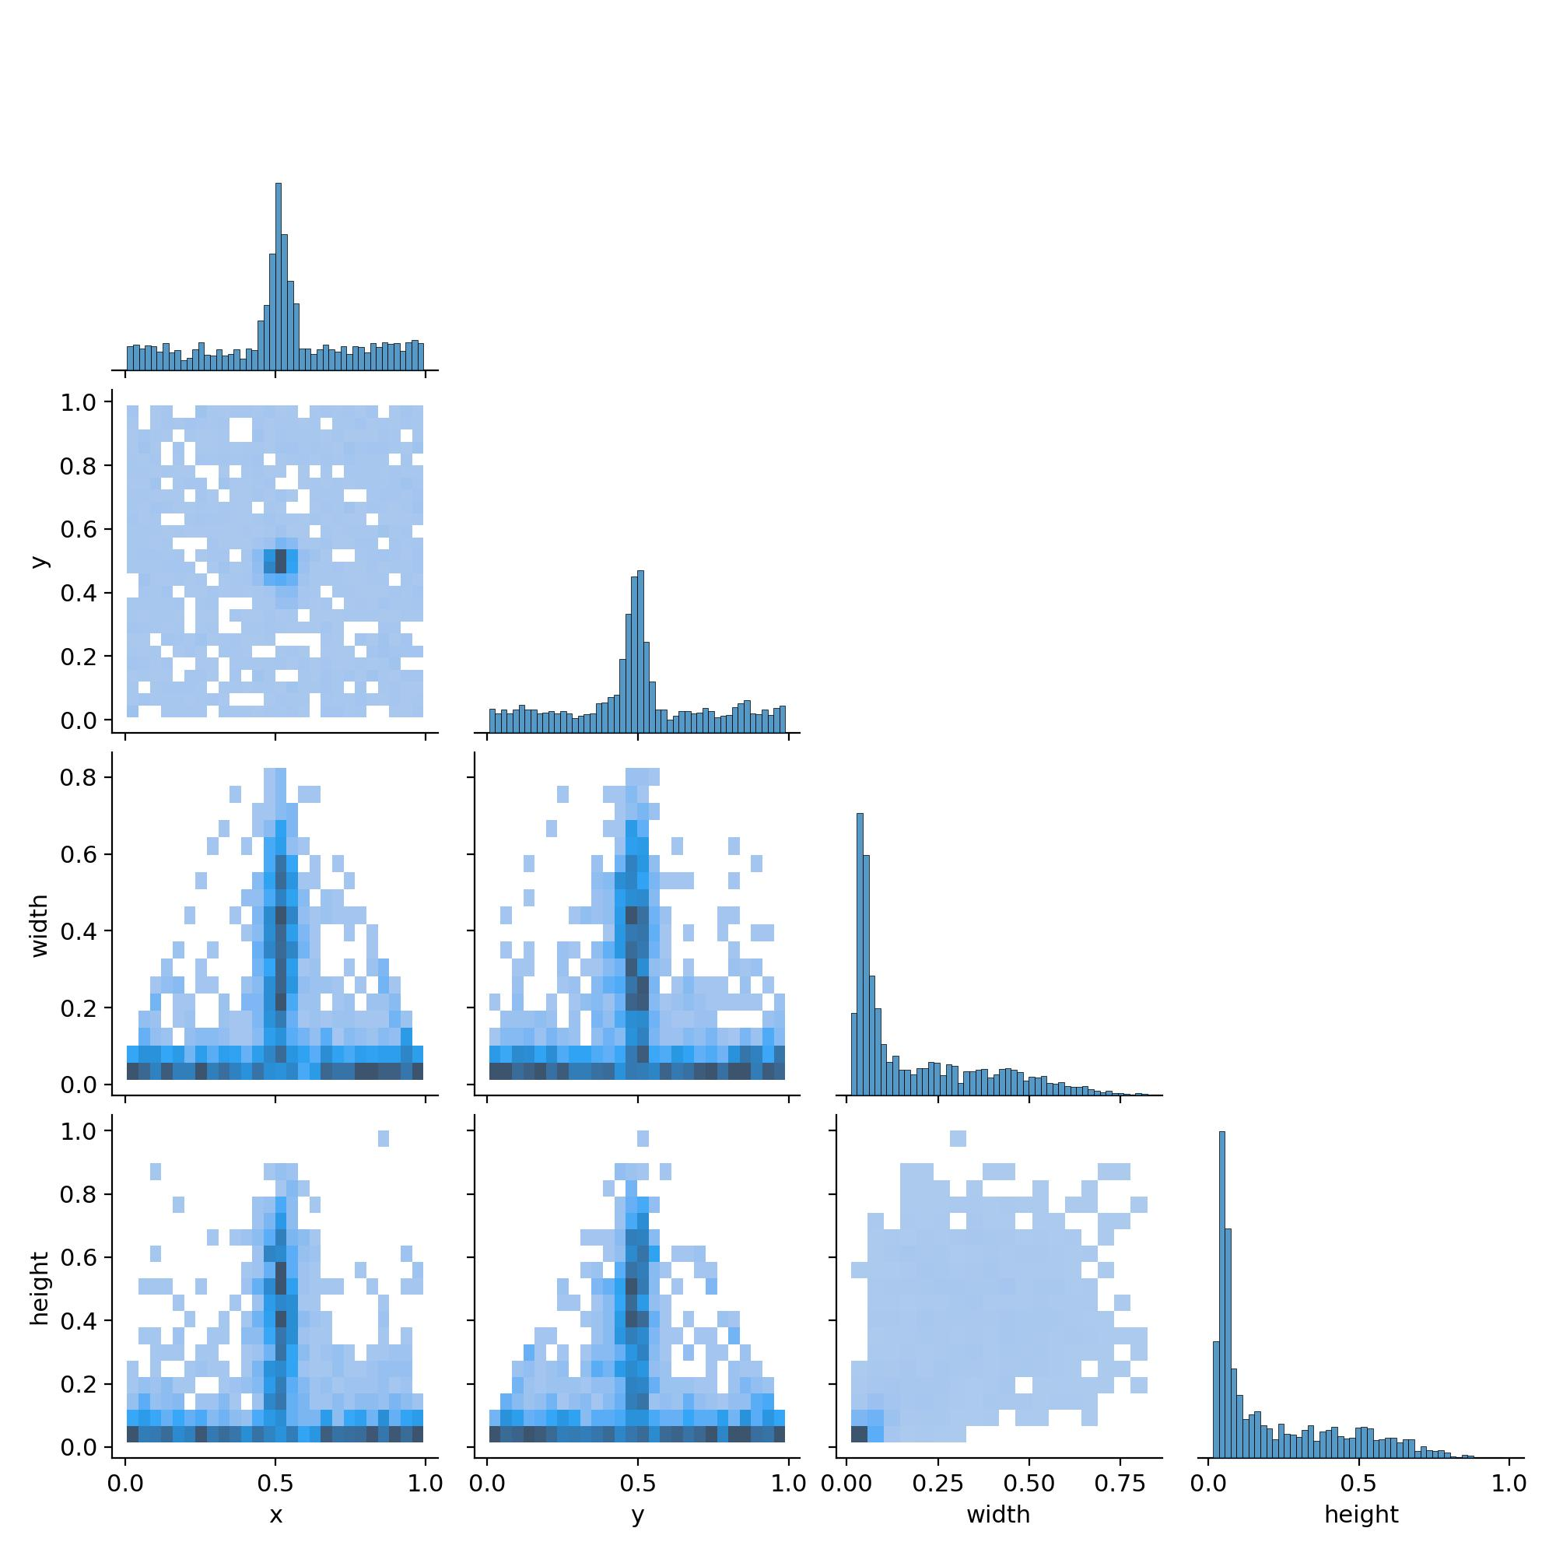
The pair plot provides a comprehensive visualization of the pairwise relationships among different dimensions of the detected objects (X, Y, Width and Height).
The diagonal displays histograms that represent the distribution of each dimension, while the off-diagonal scatter plots illustrate the interrelationships between these dimensions.
HARSH YADAV | ANANYA PAL | RAJ ANILBHAI PAWAR |SAPTARSI BHATTACHARYA | PURVANSHI SHARMA

Slide 7
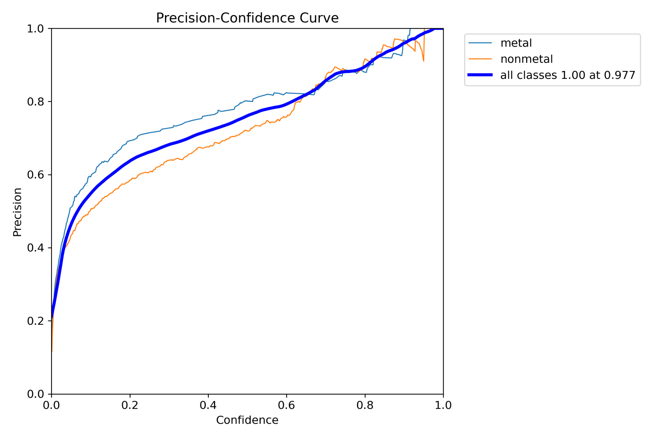
The graph illustrates how precision varies with confidence for both metal and nonmetal objects. As confidence increases, the precision for detecting metal objects (light blue line) and nonmetal objects (orange line) improves, indicating higher accuracy at higher confidence levels.
HARSH YADAV | ANANYA PAL | RAJ ANILBHAI PAWAR |SAPTARSI BHATTACHARYA | PURVANSHI SHARMA

Slide 8
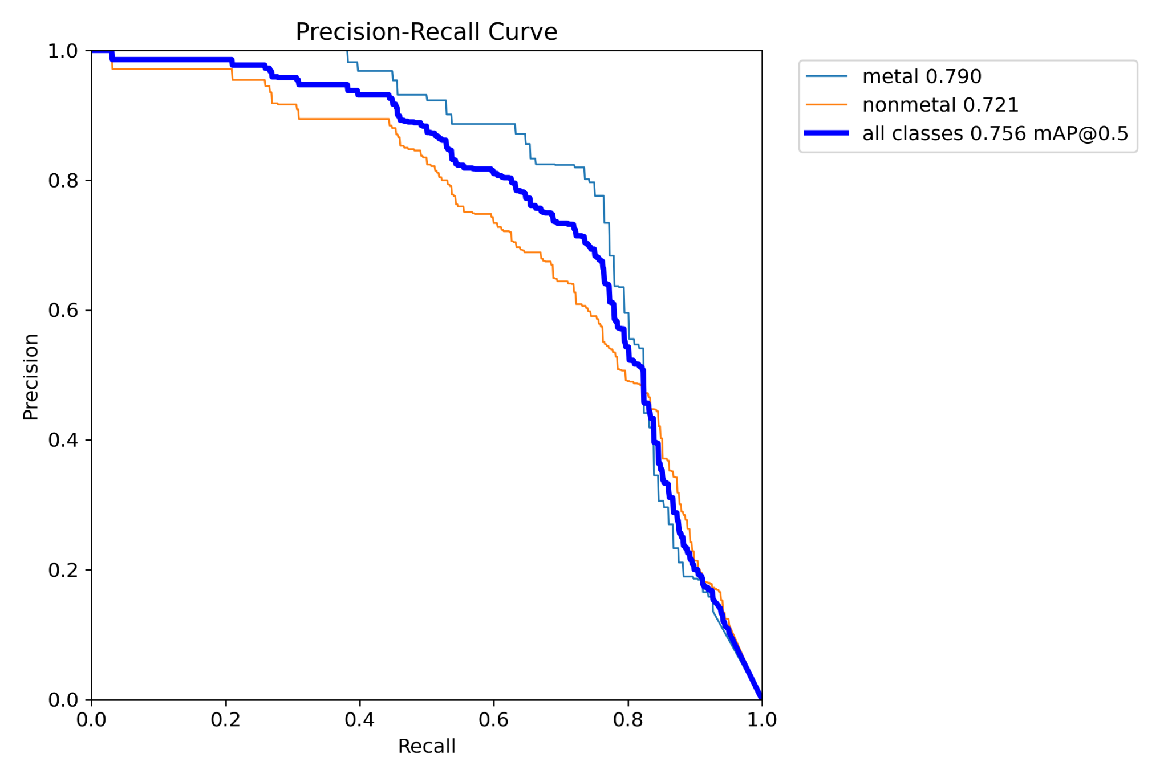
The precision-recall curve for metal objects (light blue line) shows higher precision at various recall levels compared to nonmetal objects.
The precision-recall curve for non metal objects (orange line) indicates slightly lower precision compared to metal objects.
The aggregated precision-recall curve for all classes (dark blue line) demonstrates the overall performance of the model, with a mean average precision (mAP) of 0.756 at a recall threshold of 0.5.
HARSH YADAV | ANANYA PAL | RAJ ANILBHAI PAWAR |SAPTARSI BHATTACHARYA | PURVANSHI SHARMA

Slide 9
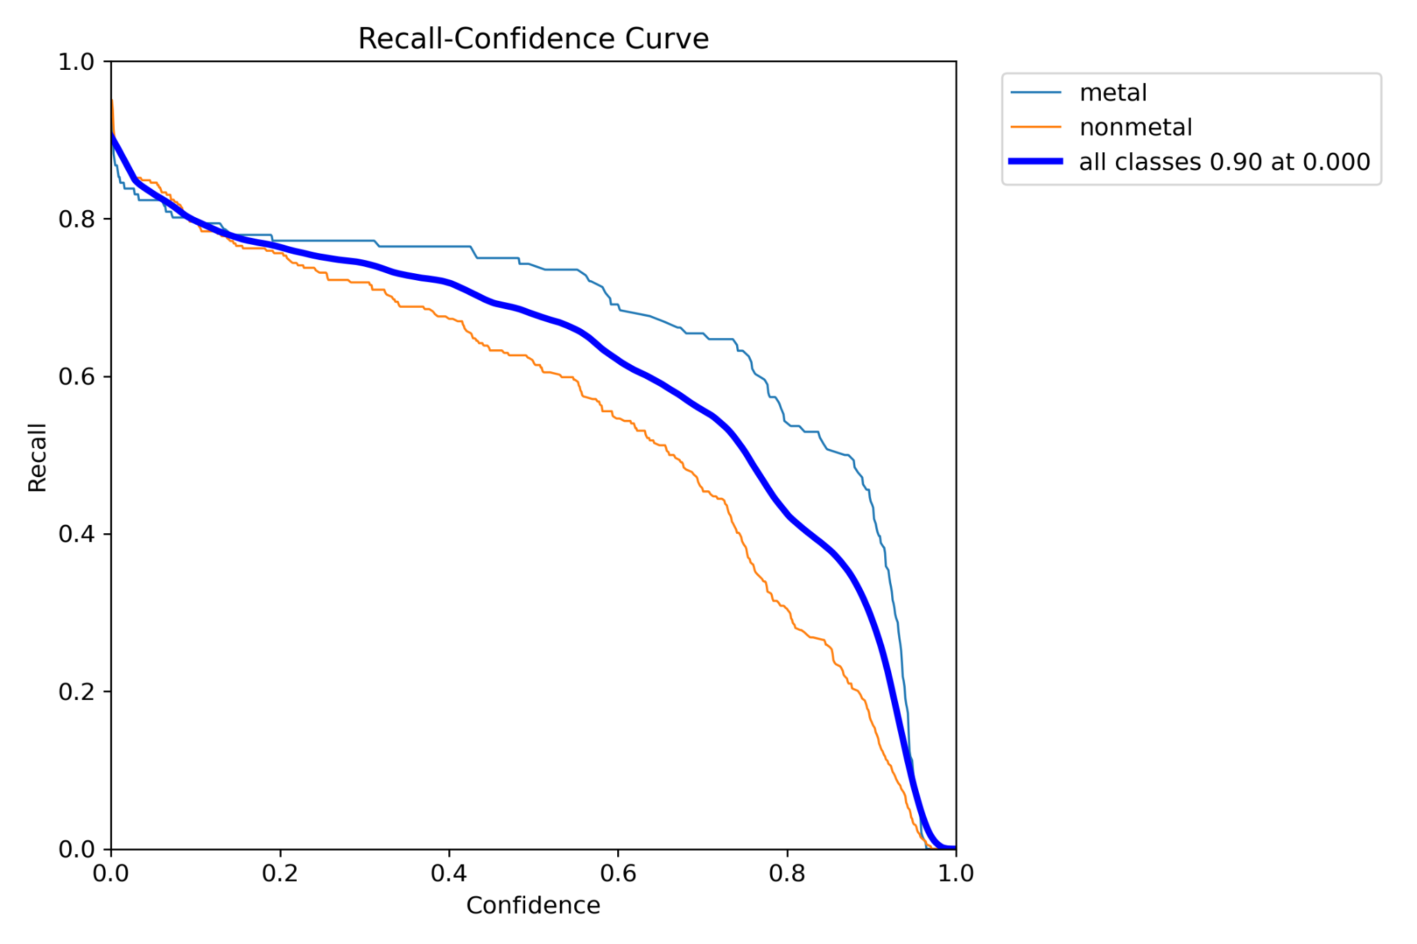
The Recall-Confidence Curve shows that the model detects "metal" objects with higher recall at higher confidence thresholds compared to "nonmetal" objects, indicating better performance for metals.
HARSH YADAV | ANANYA PAL | RAJ ANILBHAI PAWAR |SAPTARSI BHATTACHARYA | PURVANSHI SHARMA

Slide 10
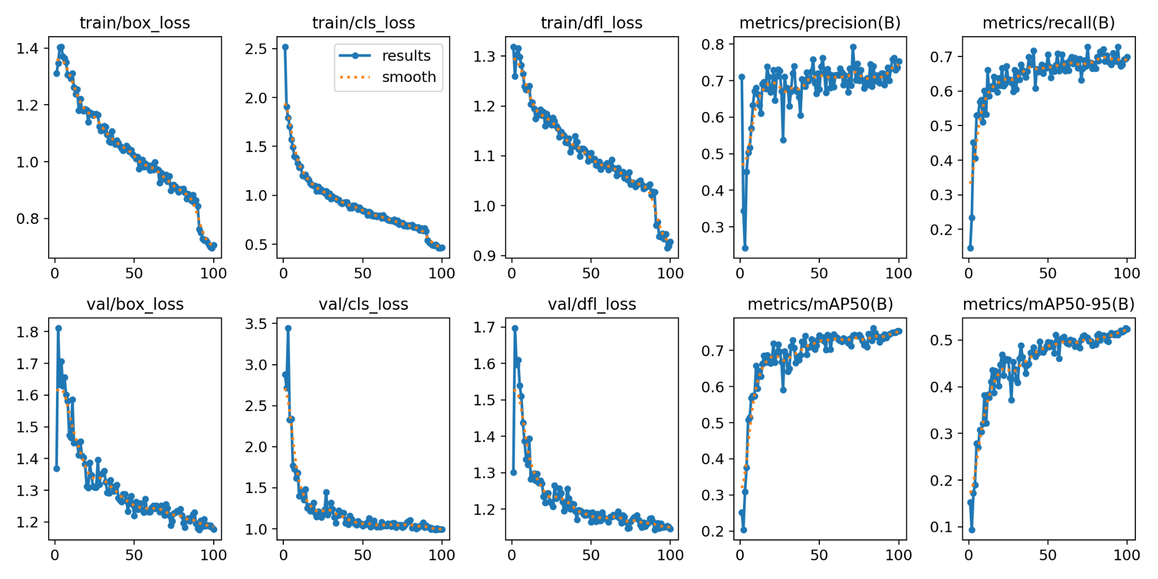
HARSH YADAV | ANANYA PAL | RAJ ANILBHAI PAWAR |SAPTARSI BHATTACHARYA | PURVANSHI SHARMA
Notes:
The training and validation metrics demonstrate a consistent decrease in loss values over 100 epochs, indicating effective learning and model convergence. Precision and recall metrics show improvement and stabilization, reflecting the model's growing accuracy and reliability in detecting objects. The mean Average Precision (mAP) metrics further confirm the model's robustness, with mAP@50 reaching around 0.7 and mAP@50-95 stabilizing around 0.5, signifying strong overall performance in object detection tasks.(many graphs)

Slide 11
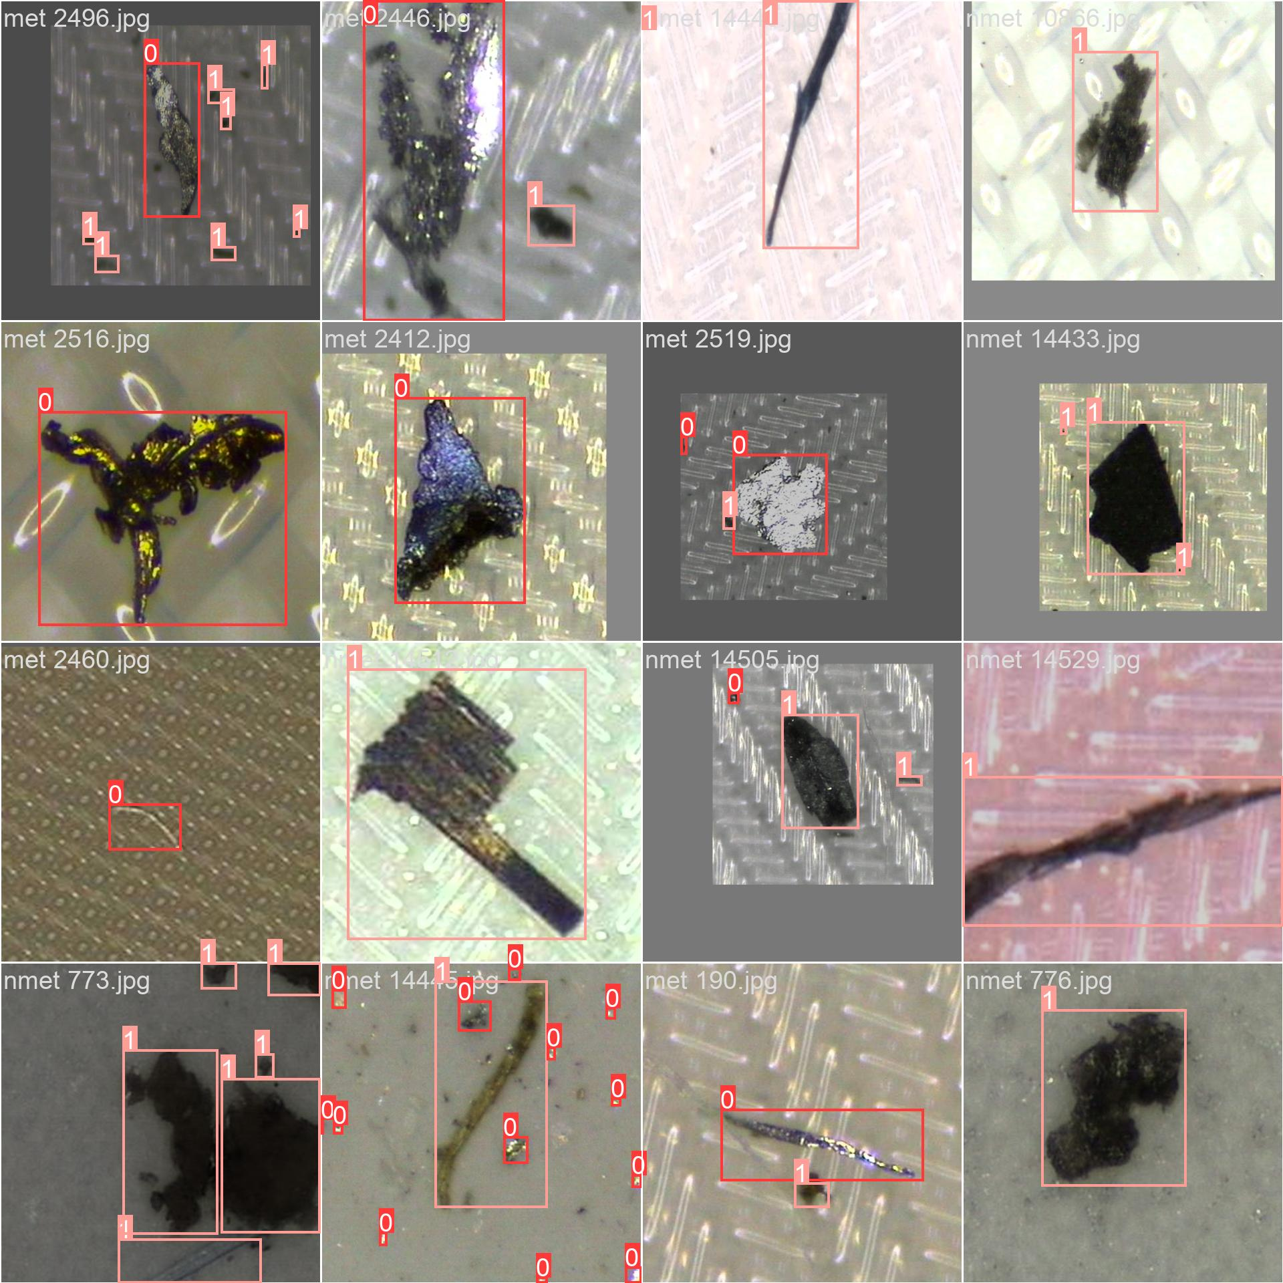
Train Batch Results
HARSH YADAV | ANANYA PAL | RAJ ANILBHAI PAWAR |SAPTARSI BHATTACHARYA | PURVANSHI SHARMA

Slide 12
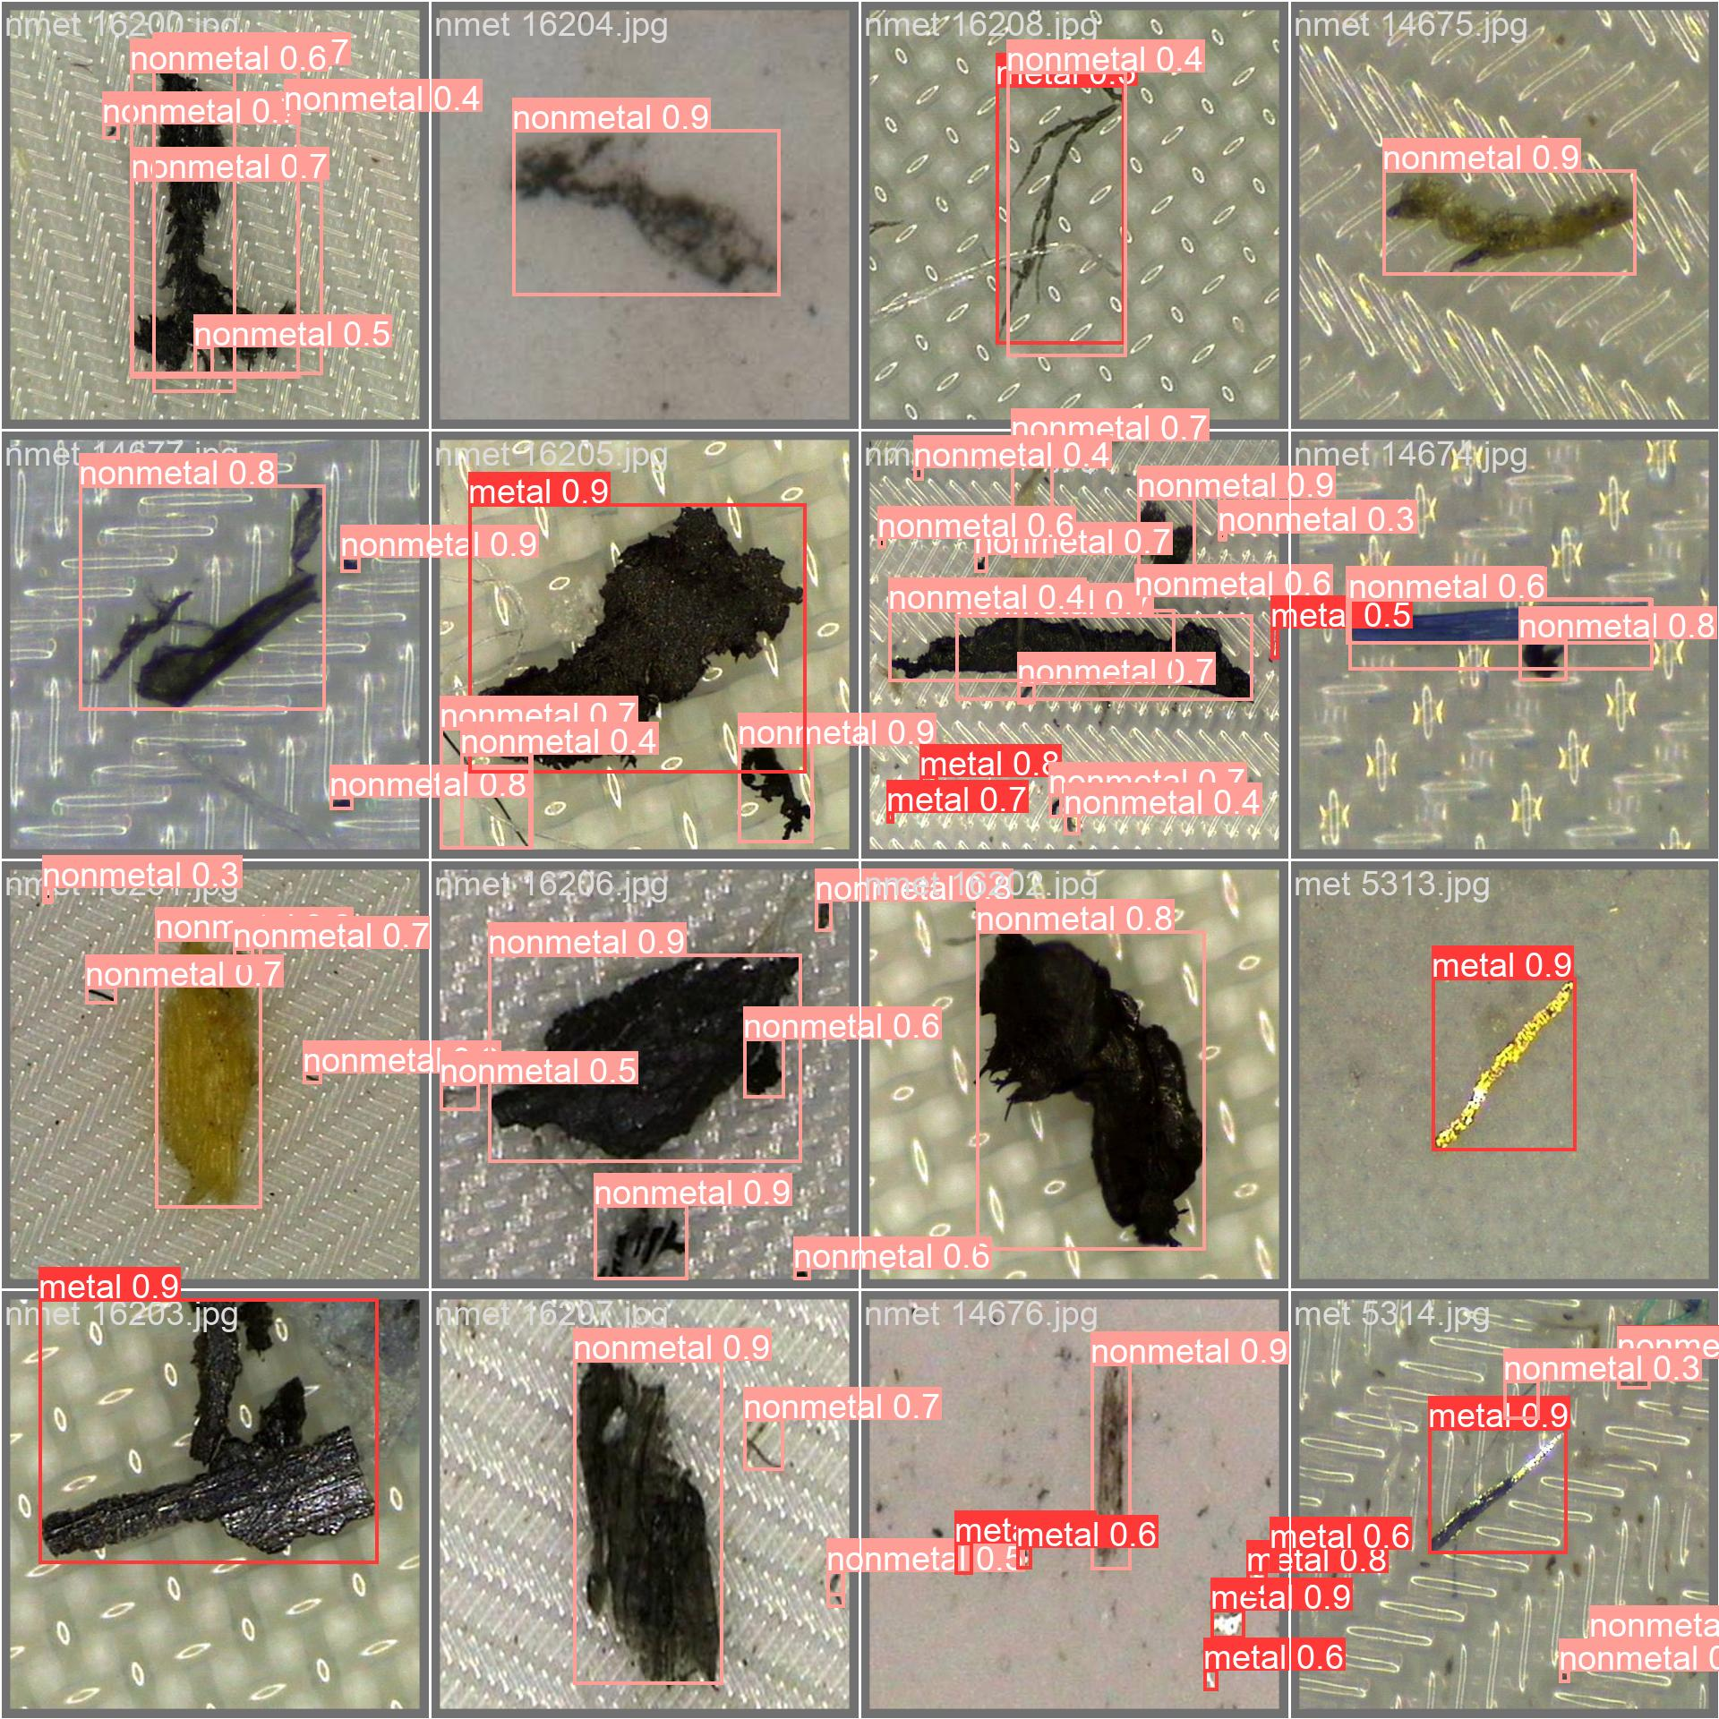
Validation Batch- Prediction Results
HARSH YADAV | ANANYA PAL | RAJ ANILBHAI PAWAR |SAPTARSI BHATTACHARYA | PURVANSHI SHARMA

Slide 13
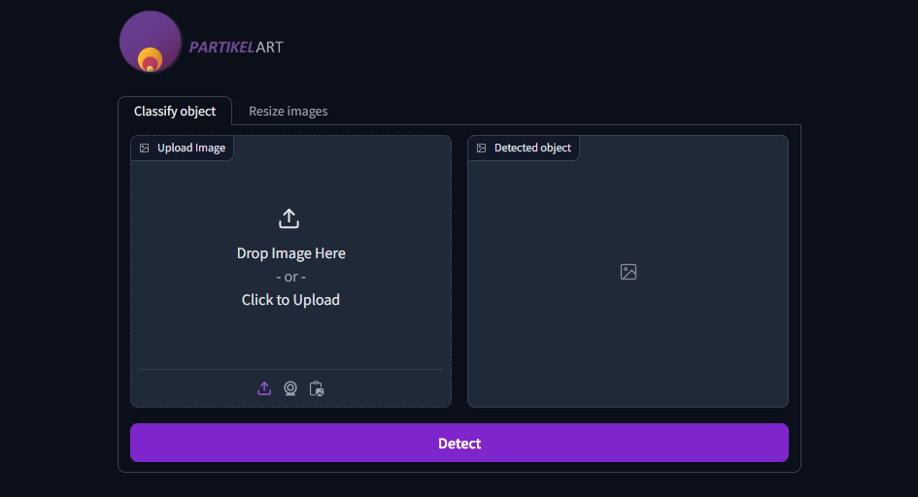
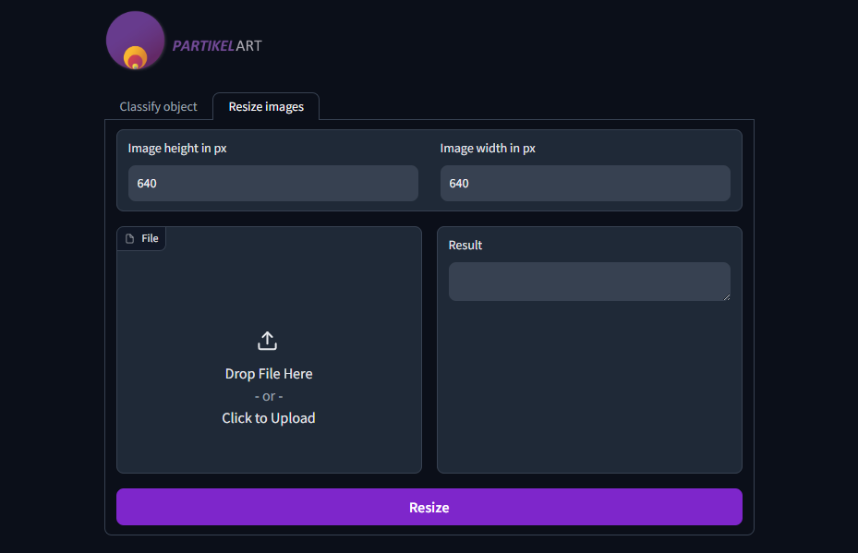
Graphical User Interface
HARSH YADAV | ANANYA PAL | RAJ ANILBHAI PAWAR |SAPTARSI BHATTACHARYA | PURVANSHI SHARMA

Slide 14
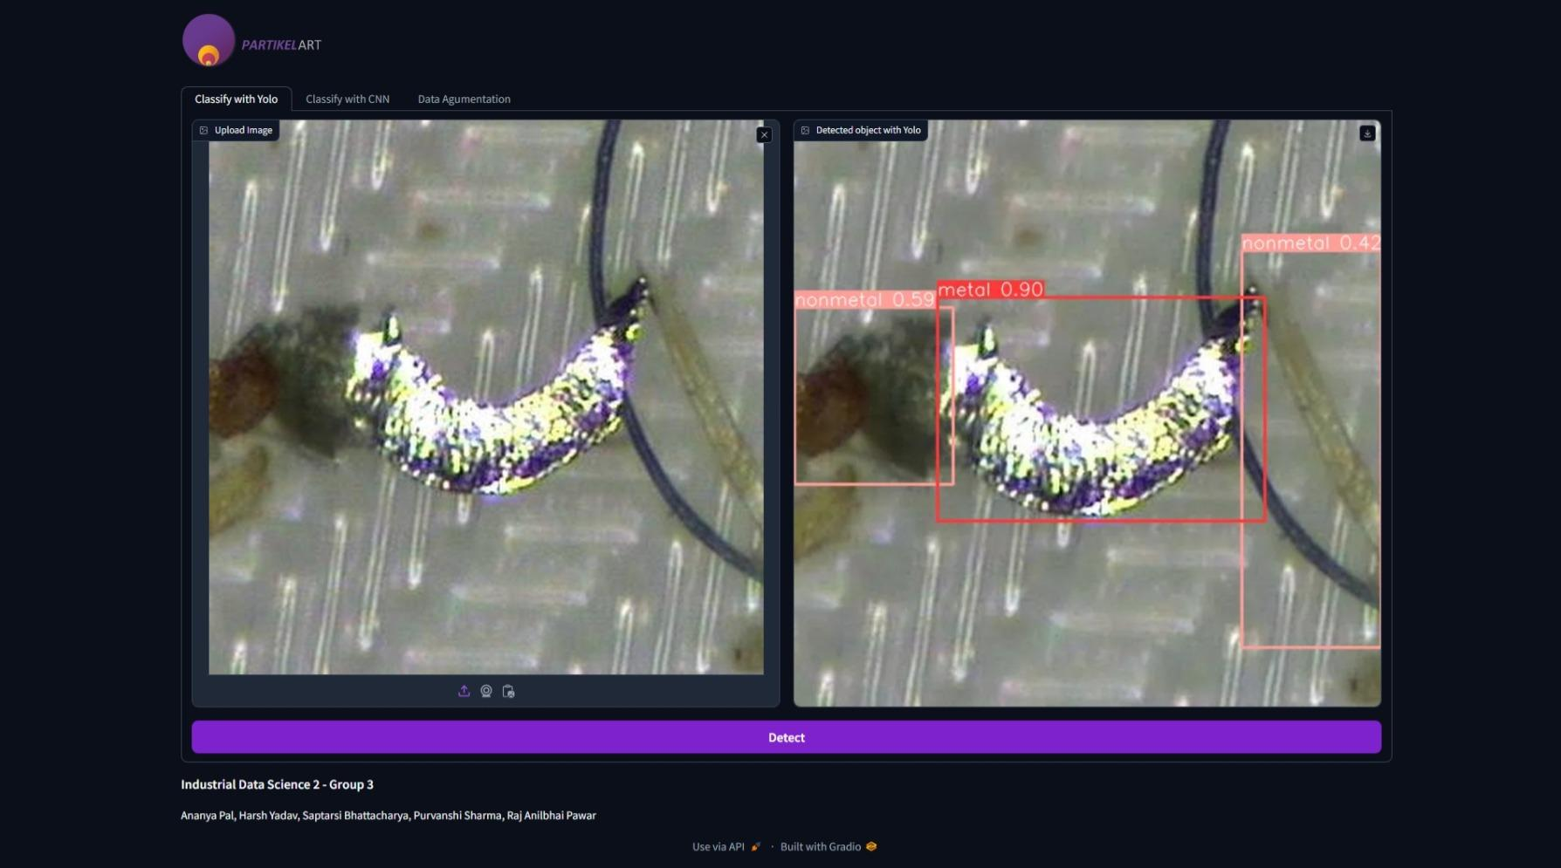
HARSH YADAV | ANANYA PAL | RAJ ANILBHAI PAWAR |SAPTARSI BHATTACHARYA | PURVANSHI SHARMA

Slide 15
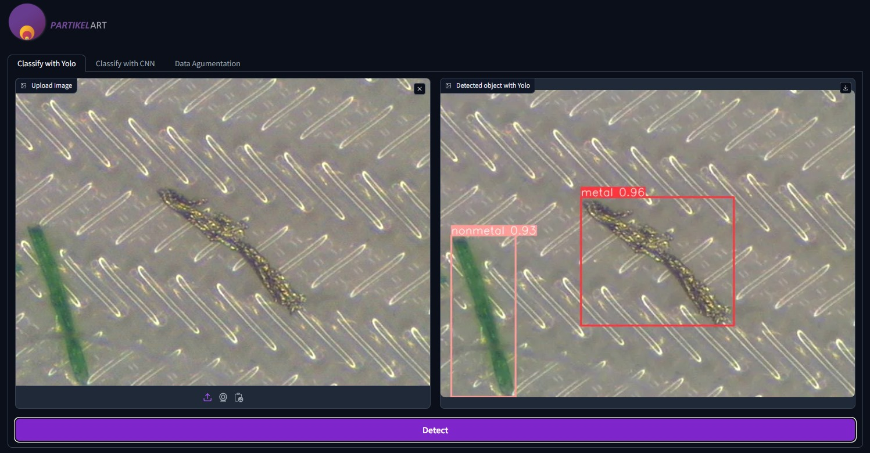
HARSH YADAV | ANANYA PAL | RAJ ANILBHAI PAWAR |SAPTARSI BHATTACHARYA | PURVANSHI SHARMA

Slide 16
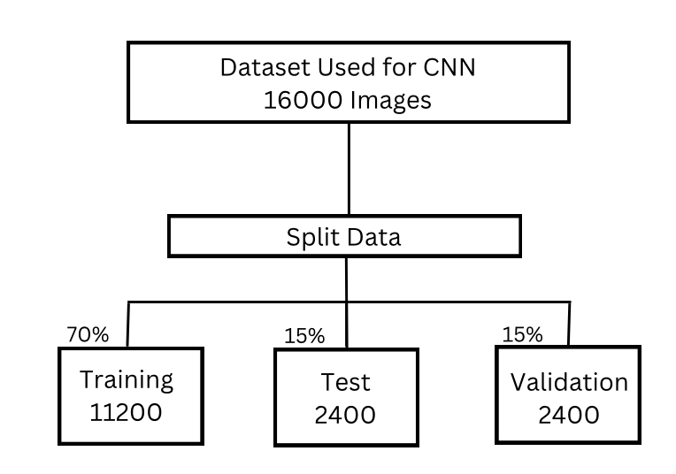
CNN Methodology
100 epochs
Batch size - 32
HARSH YADAV | ANANYA PAL | RAJ ANILBHAI PAWAR |SAPTARSI BHATTACHARYA | PURVANSHI SHARMA

Slide 17
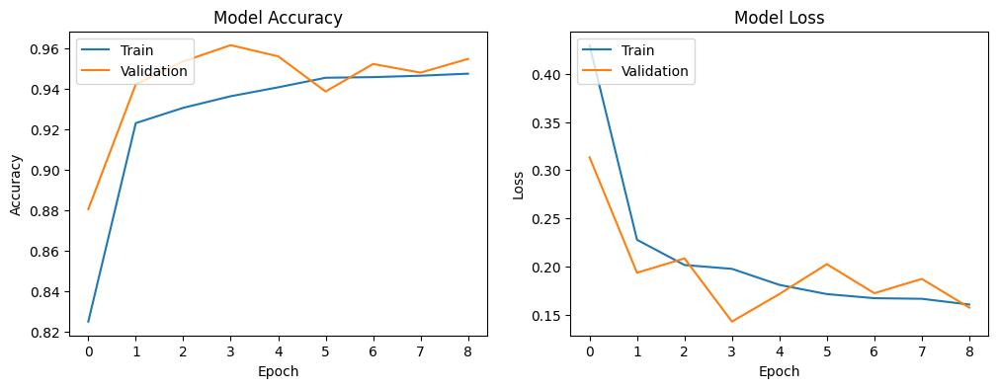
CNN Result
HARSH YADAV | ANANYA PAL | RAJ ANILBHAI PAWAR |SAPTARSI BHATTACHARYA | PURVANSHI SHARMA
Notes:
The CNN model results demonstrate robust training and validation performance over 8 epochs. The accuracy graph indicates that both training and validation accuracy converge around 95%, showcasing the model's effectiveness. The loss graph reveals a consistent decrease in both training and validation loss, with convergence around a low loss value, further indicating the model's reliability. These results suggest that the CNN model generalizes well to new data and effectively learns the patterns required for accurate classification.

Slide 18
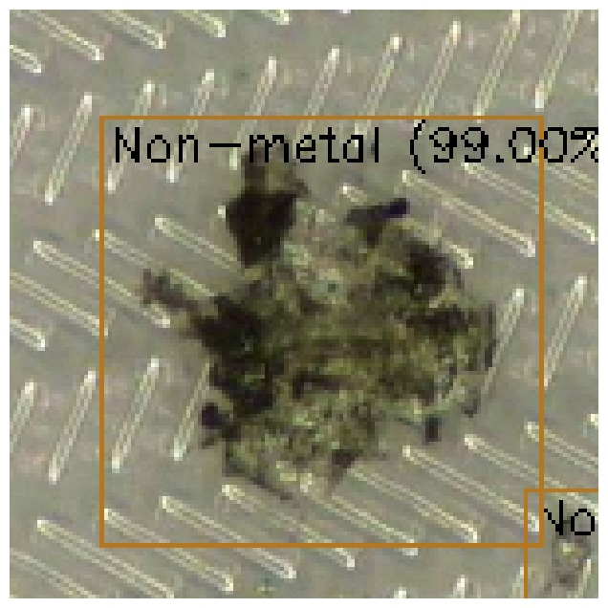
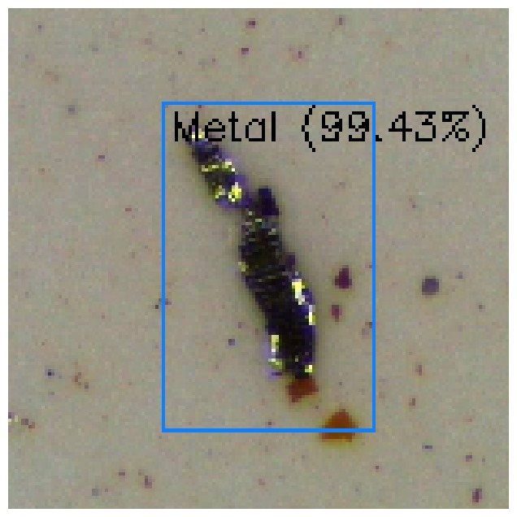
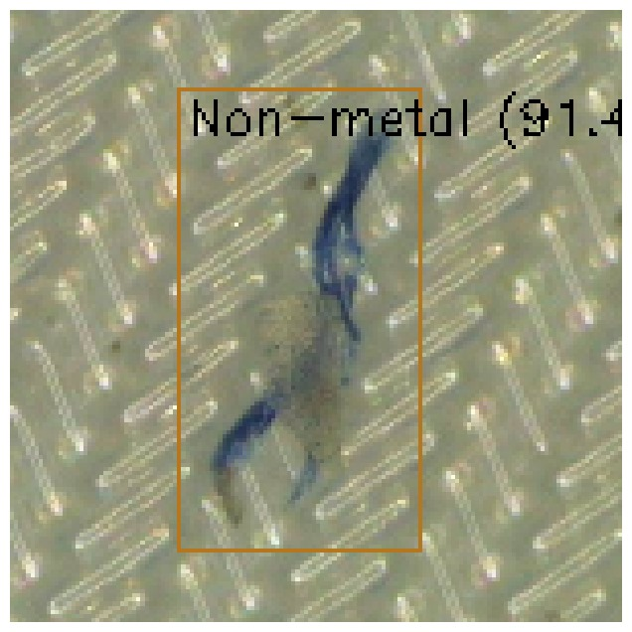
CNN Result
HARSH YADAV | ANANYA PAL | RAJ ANILBHAI PAWAR |SAPTARSI BHATTACHARYA | PURVANSHI SHARMA
Notes:
The CNN model results demonstrate robust training and validation performance over 8 epochs. The accuracy graph indicates that both training and validation accuracy converge around 95%, showcasing the model's effectiveness. The loss graph reveals a consistent decrease in both training and validation loss, with convergence around a low loss value, further indicating the model's reliability. These results suggest that the CNN model generalizes well to new data and effectively learns the patterns required for accurate classification.

Slide 19
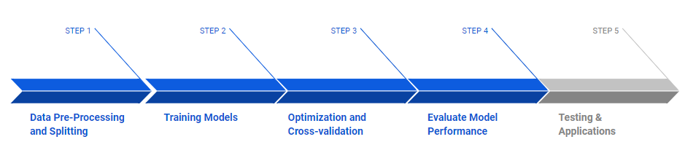
Project Flow Timeline Achieved
HARSH YADAV | ANANYA PAL | RAJ ANILBHAI PAWAR |SAPTARSI BHATTACHARYA | PURVANSHI SHARMA

Slide 20
Conclusion
We addressed the significant quality issues in industries caused by contaminants, particularly metals.
To tackle this challenge, we employed YOLO and CNN models for particle analysis and compared their results.
Custom trained YOLO v8n model (n = nano) (base model) trained over 3.2 M parameters, demonstrated its ability to accurately identify and classify particles, as shown by the validation and training results. The model shows an accuracy of 75%.
The CNN model, trained over 100 epochs with a batch size of 32, also showed promising results, showing an accuracy of 95% which is better than YOLO v8n.
The graphical user interface we developed further supports practical application and user-friendly interaction with the models.
HARSH YADAV | ANANYA PAL | RAJ ANILBHAI PAWAR |SAPTARSI BHATTACHARYA | PURVANSHI SHARMA

Slide 21
Future Work
In our future work, we plan to test our models on phone images, which are lower resolution compared to the high-resolution microscopic images. Now, we will use Transfer Learning.
This will involve:
Adapting our models to handle lower resolution images while maintaining accuracy.
Implementing techniques to enhance the quality of predictions on phone images.
Achieving a high accuracy for particle analysis on these lower resolution images, similar to the results obtained with microscopic images.
By extending our model’s capabilities to more commonly available imaging devices, we aim to make particle analysis more accessible so that anybody with PartikelART mobile app will able to identify the particles easily.
HARSH YADAV | ANANYA PAL | RAJ ANILBHAI PAWAR |SAPTARSI BHATTACHARYA | PURVANSHI SHARMA

Slide 22
References
1. YOLOv8 Model https://github.com/ultralytics, author = {Glenn Jocher, Et al.}, year = 2023, url = {https://github.com/ultralytics/ultralytics}
2. Scikit-learn, author = {Pedregosa, Et al.}, year = 2011
3. Matplotlib, author = {Hunter, Et.al.}, year = 2007
4. Tensorflow, author = {Paul and Chen, Et. al.}, year = 2016
5. NumPy, author = {Charles R. Harris, Et al.}, year = 2020
6. OpenCV, author = {Bradski, G., Et.al.}, year = 2000
HARSH YADAV | ANANYA PAL | RAJ ANILBHAI PAWAR |SAPTARSI BHATTACHARYA | PURVANSHI SHARMA

Slide 23
Q&A!
HARSH YADAV | ANANYA PAL | RAJ ANILBHAI PAWAR |SAPTARSI BHATTACHARYA | PURVANSHI SHARMA

